Slide 1
Homework – Predicate Logic
Cenan Horea-Calin
912
Exercise 3.2

Slide 2
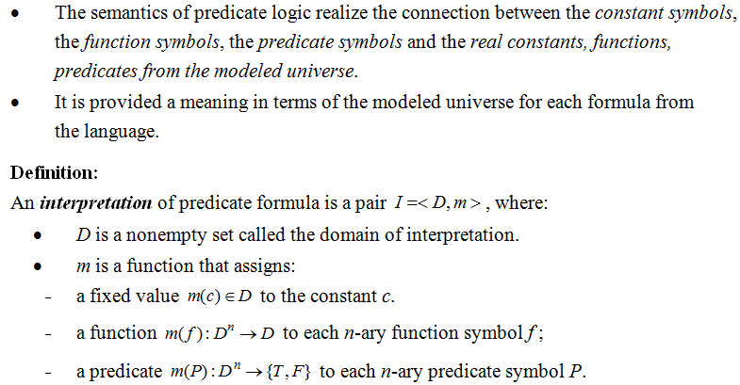
Theoretical results

Slide 3
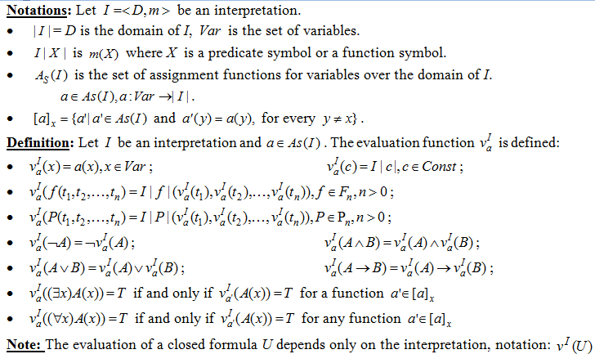
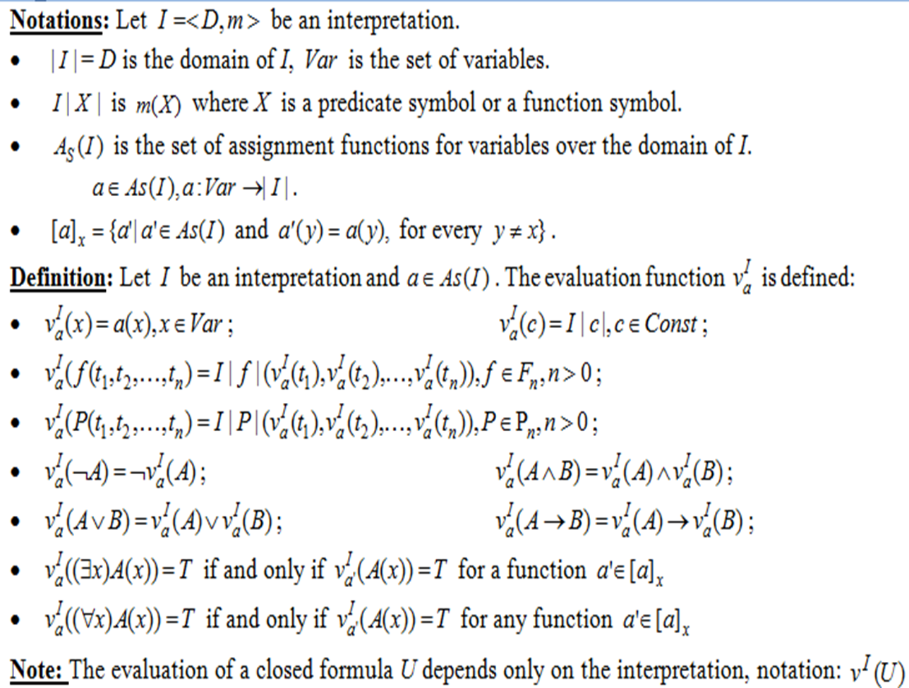

Slide 4


Slide 5
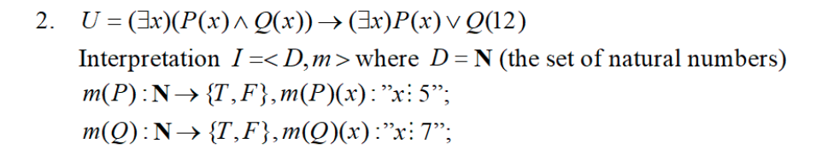
Exercise 3.2 Using the given interpretations evaluate the following formulas:
V^{I} (U) = V^{I} ((∃x)(P(x)^Q(x))) → V^{I} ((∃x)P(x)v(Q(12)))
V^{I} (U) = V^{I} ((∃x)(P(x) ^ Q(x))) → V^{I} ((∃x)P(x) v V^{I} (Q(12))
V^{I} (U)= (∃x)_{x∈N}(x:5^x:7) → (∃x)_{x∈N} (x:5)) v (12:7)
V^{I} (U) = T →T v F
V^{I} (U) = T → T
V^{I} (U) = T
Conclusion: V^{I} (U) = T, U is evaluated as True under the interpretation I.
I is a model of U ,so U is consistent

